Slide 1
Electronic Devices
Mid Term Lecture - 04
Faculty Name: Dr. Md. Kabiruzzaman
Email : Kabiruzzaman@aiub.edu
Reference book:
Electronic Devices and Circuit Theory (Chapter-2)
Robert L. Boylestad and L. Nashelsky , (11th Edition)

Slide 2
Objectives
Diodes application : AND/OR gates
Understand the process of rectification to establish a dc level from a sinusoidal ac input.

Slide 3
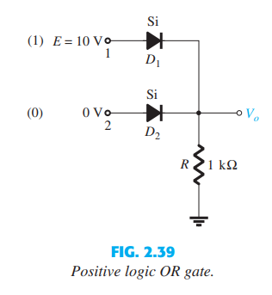
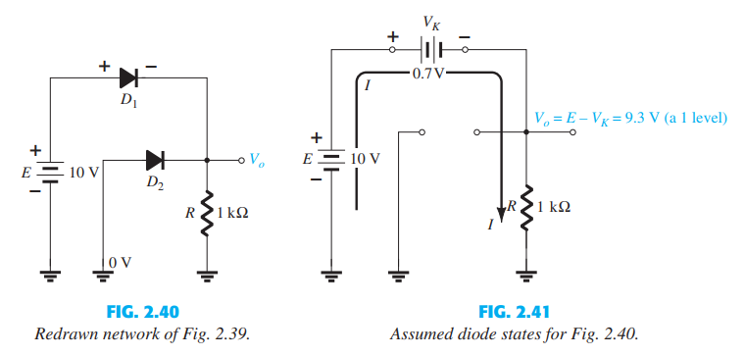
Logic OR gates
Inputs of Diode, D1 and D2 are 1 (10 V) and 0 (0 V), respectively (Fig 2.39)
Output across the resistor is 9.3 V (1 level) Fig. 2.41
For AND gates see the Example 2.15

Slide 4
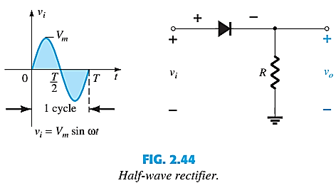
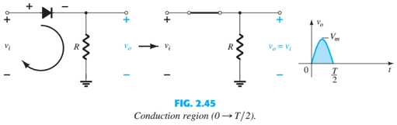
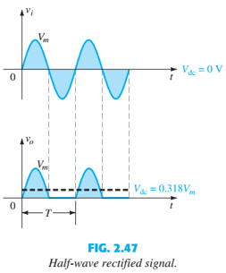
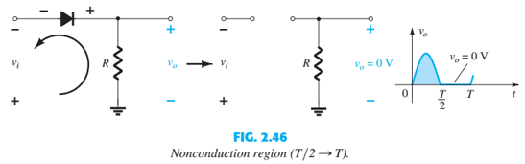

SINUSOIDAL INPUTS; HALF-WAVE

Slide 5
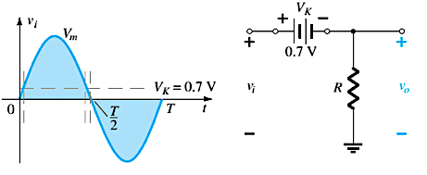
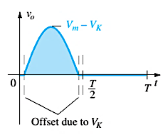

HALF-WAVE RECTIFICATION
The process of removing one-half the input signal to establish a dc level is called halfwave rectification.
The effect of using a silicon diode with V_{K} = 0.7 V is demonstrated in below Figure for the forward-bias region. The applied signal must now be at least 0.7 V before the diode can turn “on.”

Slide 6
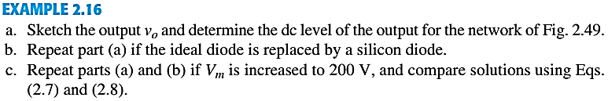
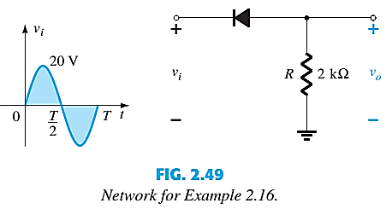
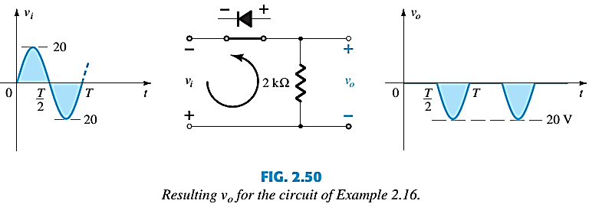
HALF-WAVE RECTIFICATION

Slide 7
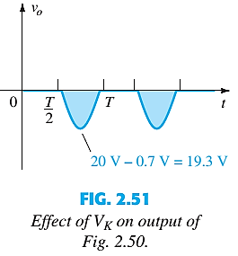
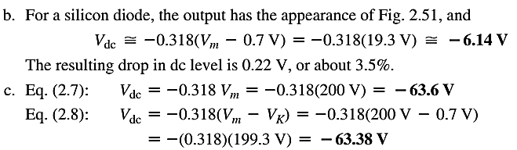
HALF-WAVE RECTIFICATION

Slide 8
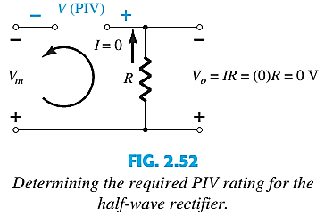

PIV (PRV)
It is the voltage rating that must not be exceeded in the reverse-bias region or the diode will enter the Zener avalanche region.
Applying Kirchhoff’s voltage law, it is fairly obvious that the PIV rating of the diode must equal or exceed the peak value of the applied voltage.

Slide 9
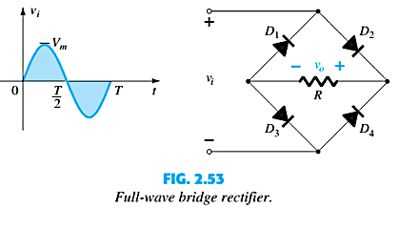
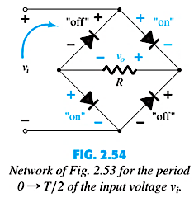
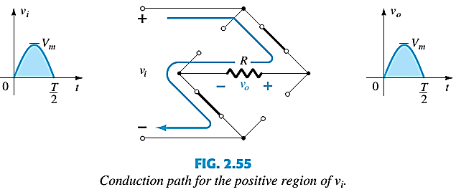
FULL-WAVE RECTIFICATION: BRIDGE NETWORK

Slide 10
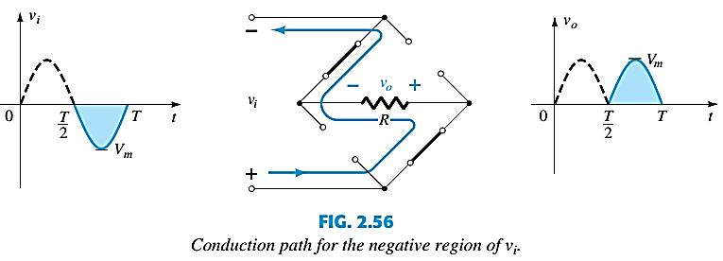
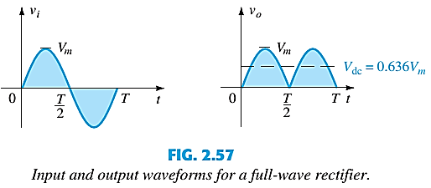
BRIDGE NETWORK

Slide 11
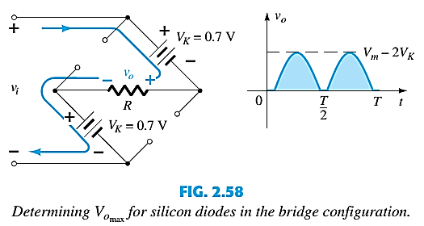

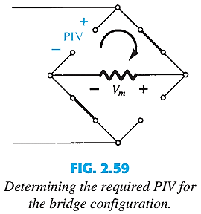

BRIDGE NETWORK

Slide 12
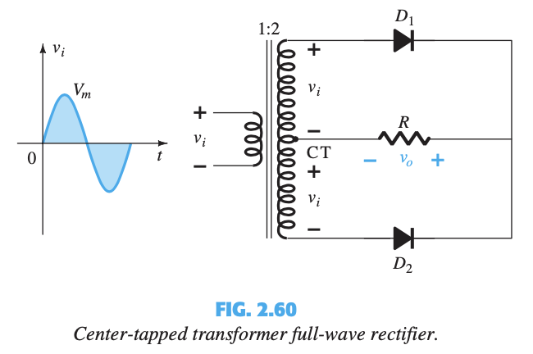
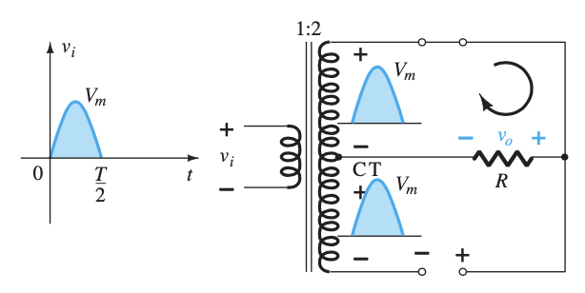
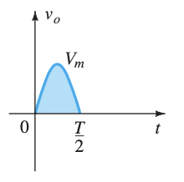
CENTER-TAPPED TRANSFORMER
Network conditions for the positive region of v_{i}

Slide 13
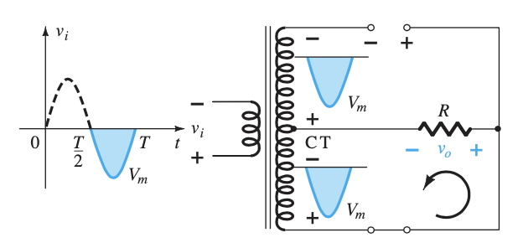
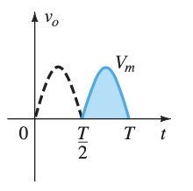
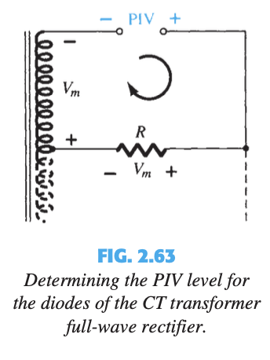
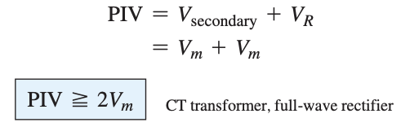
CENTER-TAPPED TRANSFORMER
Network conditions for the negative region of v_{i}

Slide 14
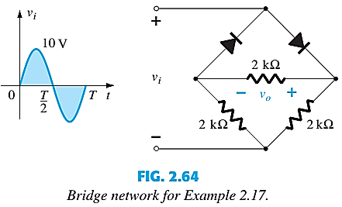
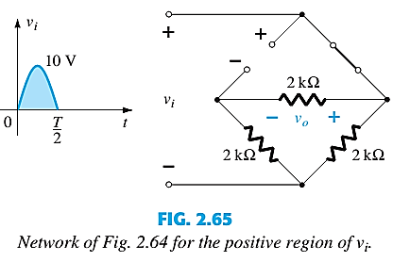
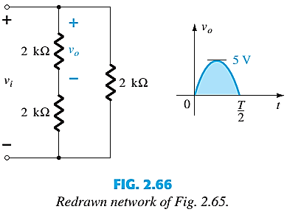
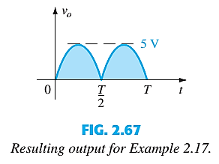

Slide 15
PIV analysis
***The PIV as determined from Fig. 2.59 is equal to the maximum voltage across R , which is 5 V, or half of that required for a half-wave rectifier with the same input.

Slide 16
Thank You

